Slide 1


Slide 1
GPA MAPPER
- By Devul Nahar -

Slide 2
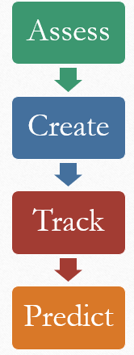
What is gpa mapper?
Notes:
This app helps users assess, create, track, and predict their grades throughout school and college all in one easy to use application.

Slide 3
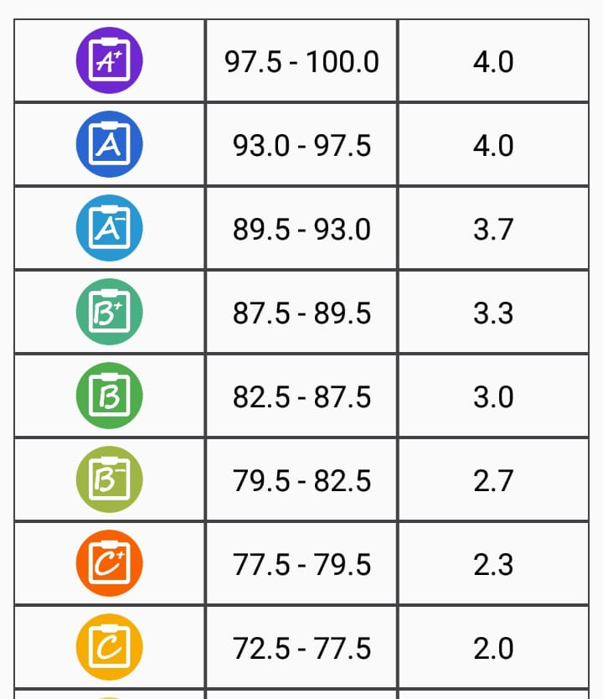
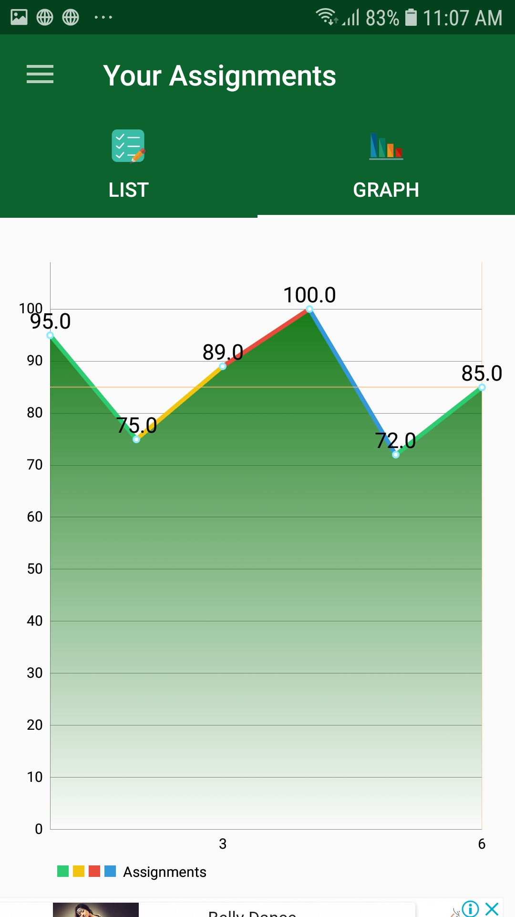
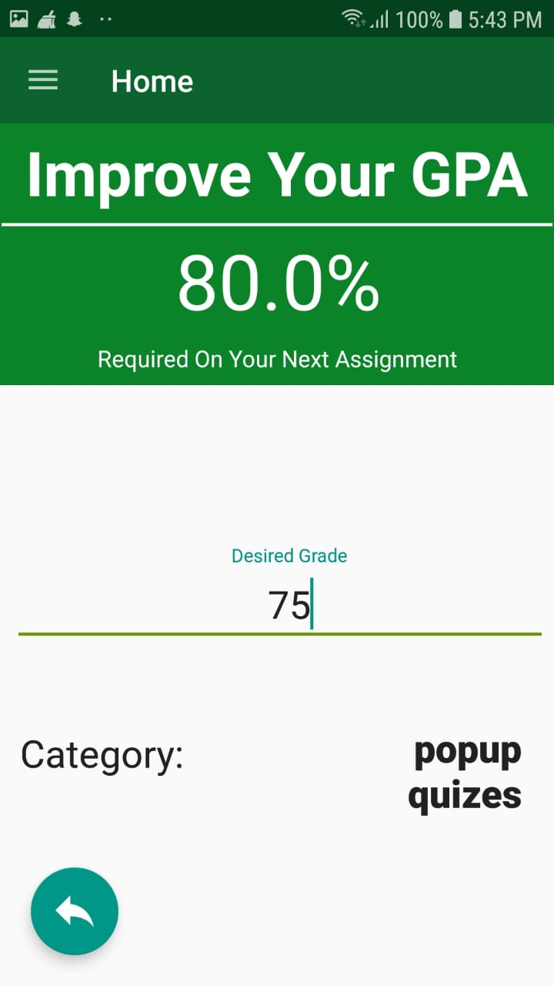
What is gpa mapper?
Notes:
The app will be able to full fill this objective by rendering various graphs, tables, and prediction models based on their contemporary and pre-existent grades on assignments, projects, tests, exams, etc for that semester/grade. The prediction models and a permanent database for tracking their grades and easily managing them are some of the features that would specifically make this app stand out from other GPA applications.

Slide 4

Who is GPA Mapper for?
An App designed with you in mind!
This app is for those students, both schools and colleges struggling to get the big picture of how they are performing academically and want to plan their grades to achieve their aspired goals.

Slide 5




Why use GPA Mapper?
Why use GPA Mapper?
Profile your entire high school profile over multiple years!
Easily visualize strengths and weaknesses!
Identify key trends from charts and graphs!
Plan your grades, and improve your GPA!

Slide 6

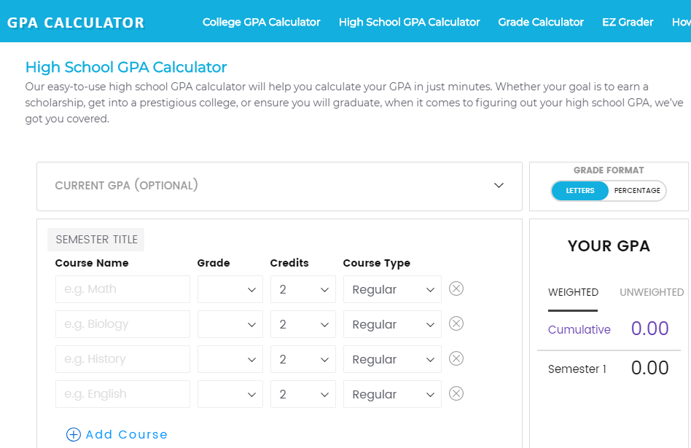
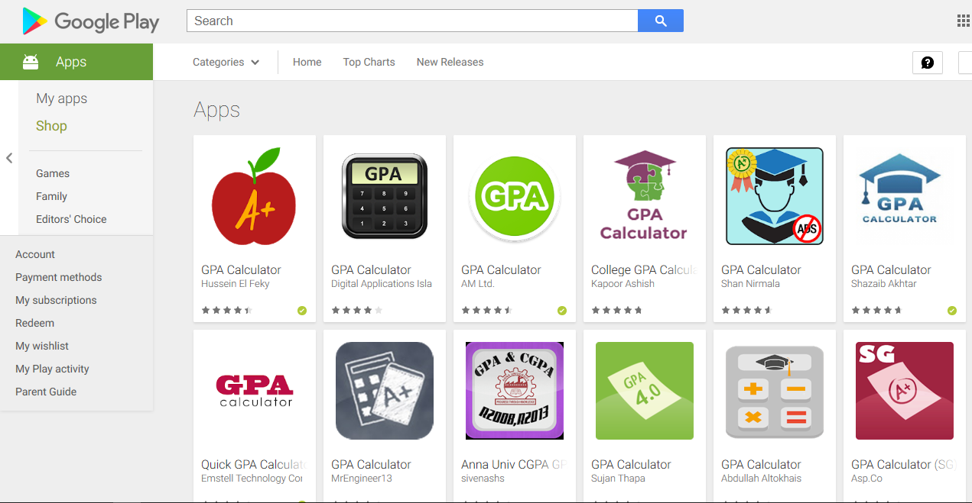
When Will you use this app?
Notes:
Although there are websites online where the user can access grades, the user is never really able to get the full picture of all their subjects until the report card, without doing tiresome and fallible calculations themselves.

Slide 7

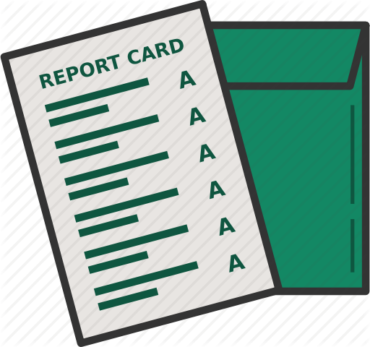

When Will you use this app?
When Will you use this app?
KNOW
CONTROL
Notes:
This app serves to simply all that without the users having to wait for the report card being astounded by receiving grades they did not expect. Through this app, the user will KNOW and have CONTROL over your grades without any speculations.

Slide 8

How to use this app?

Slide 9


Login Page
1
Enter Username
2
Select a Personal Picture

Slide 10
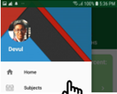
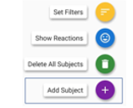
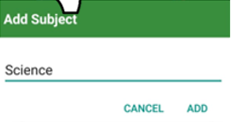
Adding a subject
1
2
3
Go to the Menu
Select Subjects
Select Add Subject

Slide 11
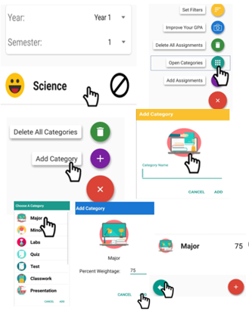
Adding an assignment
Select Subject
1
2
Click the Floating Button again, and then select add category.
3
Then Click the floating button and press add category option
Select the category name by clicking on the image.
4
Specify a percentage Weightage for that category. (Make sure that the percentage for categories all add up to a 100%, and that you have no categories with the same name)
5
6
Select Add Category
7
Go back to the Assignments Screen by clicking the back button.

Slide 12
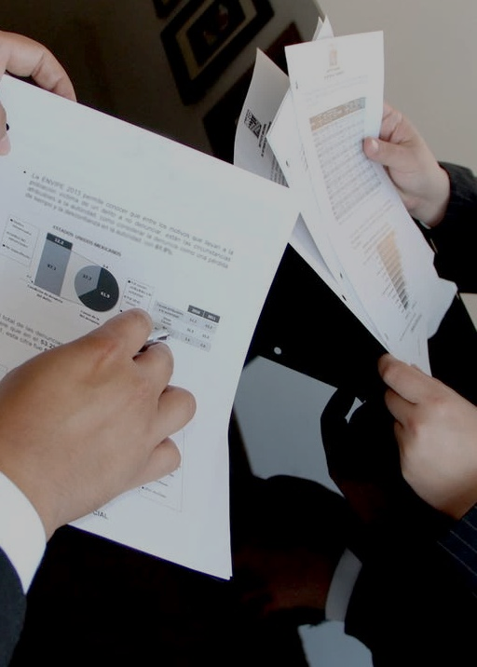
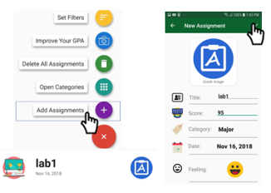
Slide 6
8
8) Click the Floating menu button and select add assignment
9
9)Type in the details and click add assignment

Slide 13
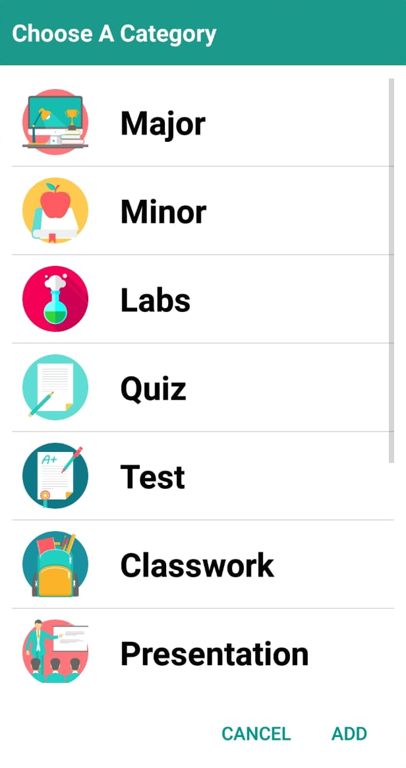
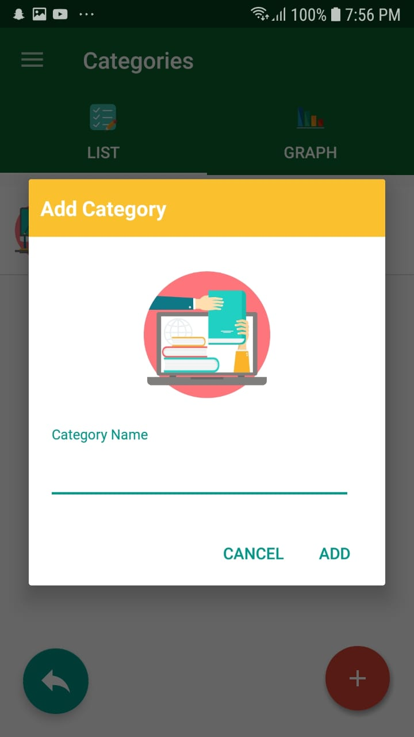

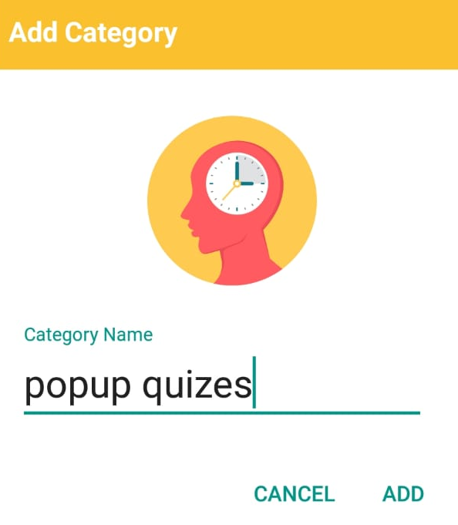
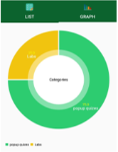
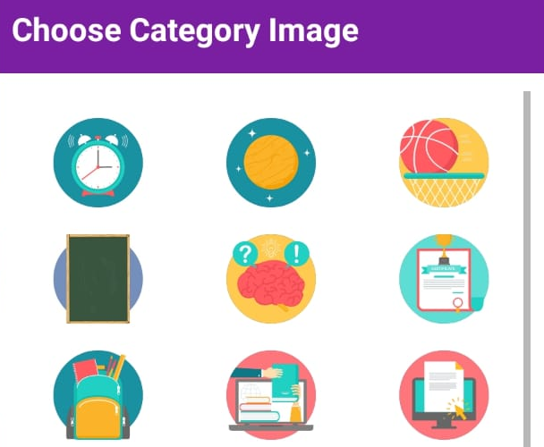

Adding a category
1
2
3
4
Type the name of the category, and hit enter
Tap the image icon, to choose a custom icon for the category
Select the category you just added.
When you are showed a list of all the categories, select add category.

Slide 14
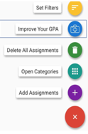
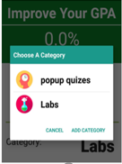
Plan and improve your grades
1
2
3
Click the floating action button, and select Improve Your GPA.
Select the category of the next assignment.
Enter the desired grade, and see the required grade for next assignment

Slide 15
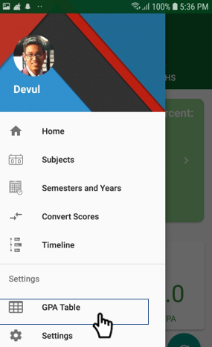
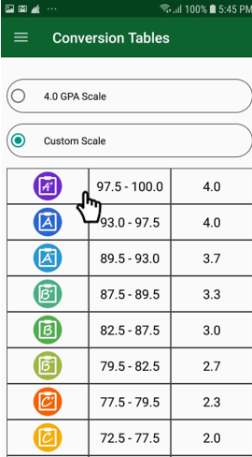
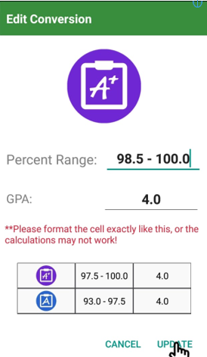
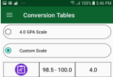
Change conversion/gpa Tables
Tap the menu button and select conversion Tables.
1
2
Select the Custom GPA Button.
3
Tap on any of GPA Conversions
4
Follow the exact format provided or the app may not work.

Slide 16

What to do If the app malfunctions?
Try updating the default year and semester.
Restart App
1
3
Press the Refresh Button on Main Screen
2
4
Try adding more data (like subjects).

Slide 17
Quotes
“This app is useful for students, like me, who are curious about their GPA but are too busy to calculate it on their on. The UI is quite intuitive and easy to learn”~ Grade 11 student
“This APP provides a unique solution to a lot of our everyday problems, and we fully support with advancing his app in the future!” ~ School Counsellor
School Counsellors at Ittihad private school
School Counsellors at Ittihad private school

Slide 18




Contact information
.
devulnahar@gmail.com
+971529112640
devul_nahar

